Slide 1
Computational Foundations for ML (10-607):
Overview & Propositional Logic
Bryan Wilder
* Slides borrowed from prior offerings of the course by Professors M. Gormley, P. Virtue, & G. Gordon.

Slide 2
Course Overview
Goals:
A formal presentation of computational background needed to understand ML
Motivated by (carefully chosen) real-world problems that arise in ML applications,
Audience:
students wishing to prepare for future coursework in Machine Learning

Slide 3
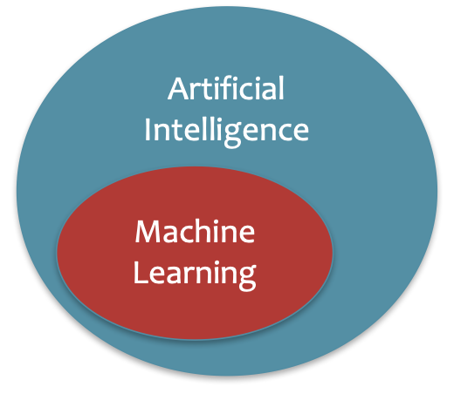
What is Artificial Intelligence?
The basic goal of AI is to develop intelligent machines.
Intelligence is the computational part of the ability to achieve goals in the world.
This consists of many sub-goals:
Perception
Reasoning
Control/Motion/Manipulation
Planning
Communication
Creativity
Learning
…
Notes:
http://www-formal.stanford.edu/jmc/whatisai/whatisai.html

Slide 4
What is Machine Learning?
Machine learning aims to design algorithms that automatically extract valuable information from data by modeling the data-generating process.
Data
Model
Learning

Slide 5
What is Machine Learning?
Machine learning aims to design algorithms that automatically extract valuable information from data by modeling the data-generating process.
Data → Vectors, Matrices, Data Structures
Model → Probability
Learning → Optimization, Algorithm Design and Analysis

Slide 6
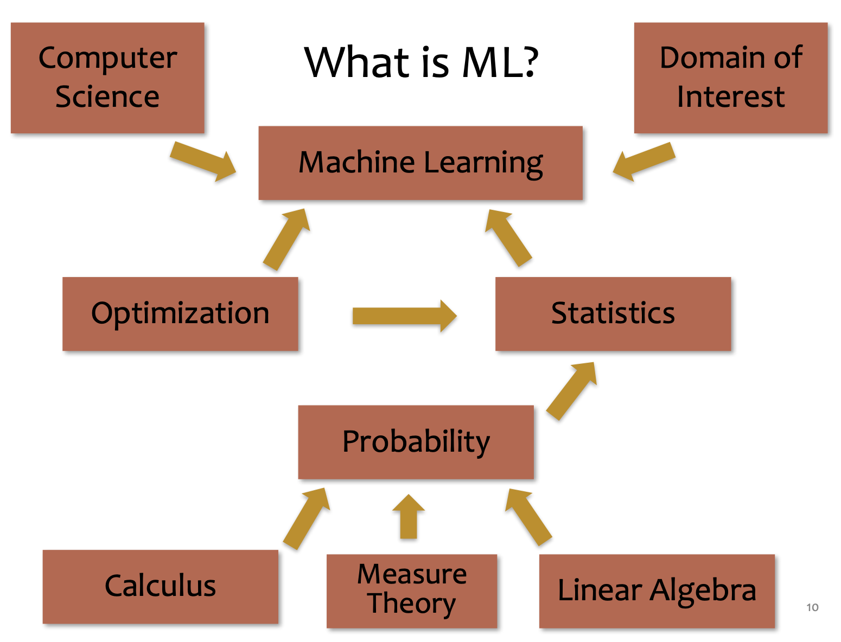
What is Machine Learning?

Slide 7
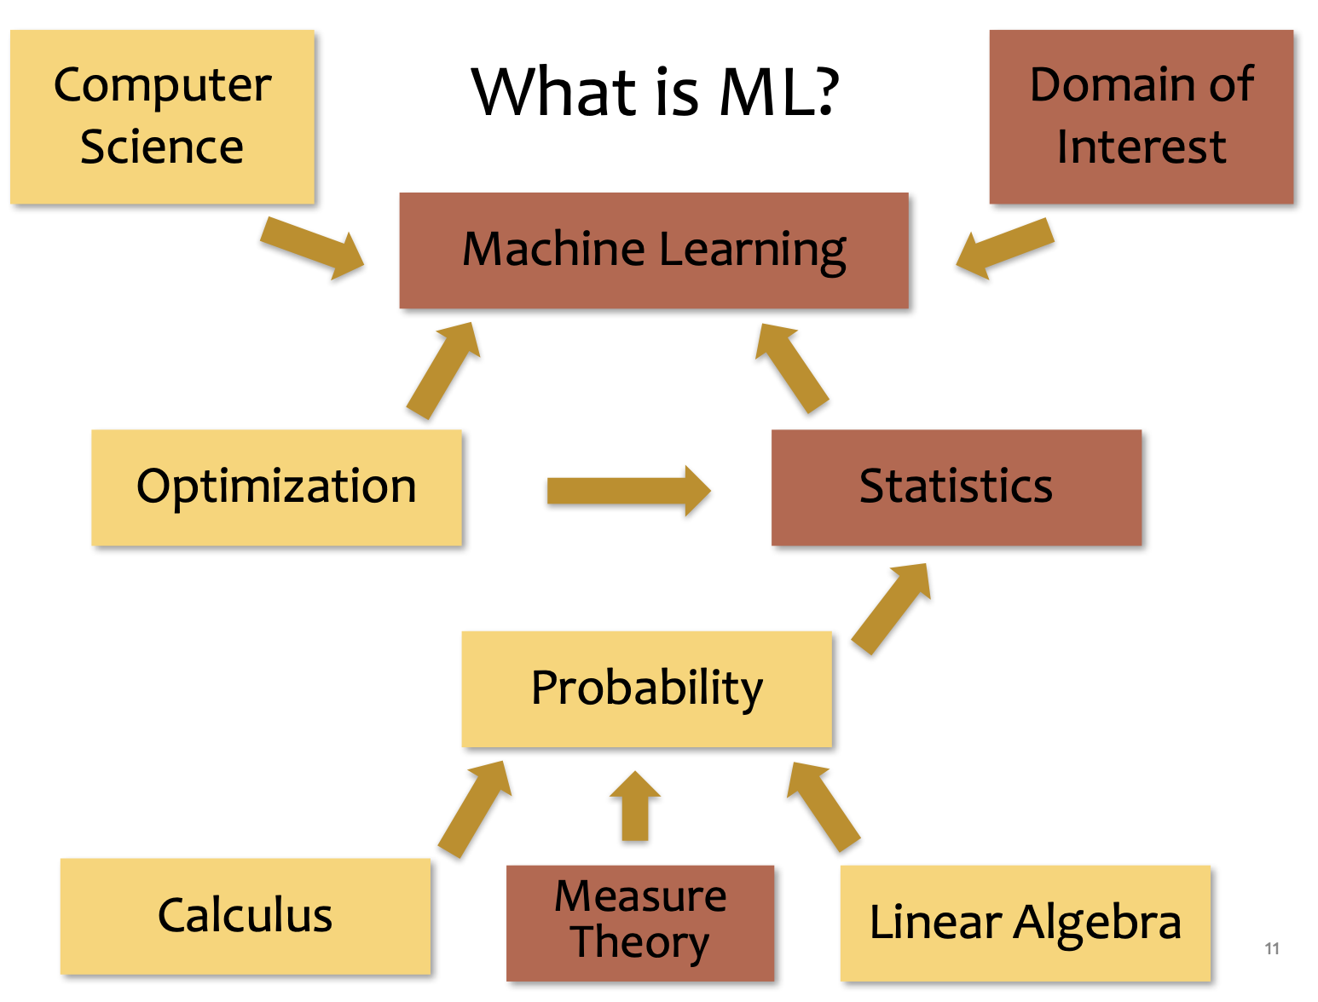
What is Machine Learning?

Slide 8
This course
Writing formal proofs
Propositional logic
Proof strategies
Computational complexity
Data structures
Algorithms

Slide 9
Course website
https://github.com/bwilder0/10607-f23 (Link also in canvas)
This is where we will maintain the class schedule, post lecture notes, etc. Also has the syllabus and policies.
Assignments: Canvas, submitted via Gradescope
OH Schedule: Canvas

Slide 10
Grading and policies
50%: Homeworks due each week (gradescope)
First one due Sunday!
50%: 3 in-person quizzes
All information is on the course website: https://github.com/bwilder0/10606-f23

Slide 11
Course structure
Monday/Wednesday: lecture with instructor
Friday: recitation with TA
Sunday EOD: homework due

Slide 12
Expected Background
We’re assuming mathematical maturity: you should be familiar with the idea of derivations and proofs, and of building formal representations for objects given their English­ description.
We’ll assume that you can take scalar derivatives.
We’ll assume that you’ve seen real vector spaces and matrices (linear operators) and know how to reason about things like matrix multiplication and solving systems of linear equations.
We’ll assume that you’ve seen sets and data types.
We’ll assume that you’ve worked with probabilities (e.g., conditioning, Bayes rule).
We will also assume familiarity with coding. The assignments and in-class activities will include some Python.

Slide 13
Why Computer Science for ML?
10-607
To best understand A we need B
A | B
Analysis of Inference in Graphical Models | Computation Computational Complexity Recursion; Dynamic Programming
Implementation Design of a Deep Learning Library | Programming & Efficiency Debugging for Machine Learning Data structures and algorithms for automatic differentiation
Optimization algorithms for training neural networks | Optimization Unconstrained Optimization Preconditioning, momentum, adaptation
Slide credit: CMU MLD Matt Gormley

Slide 14
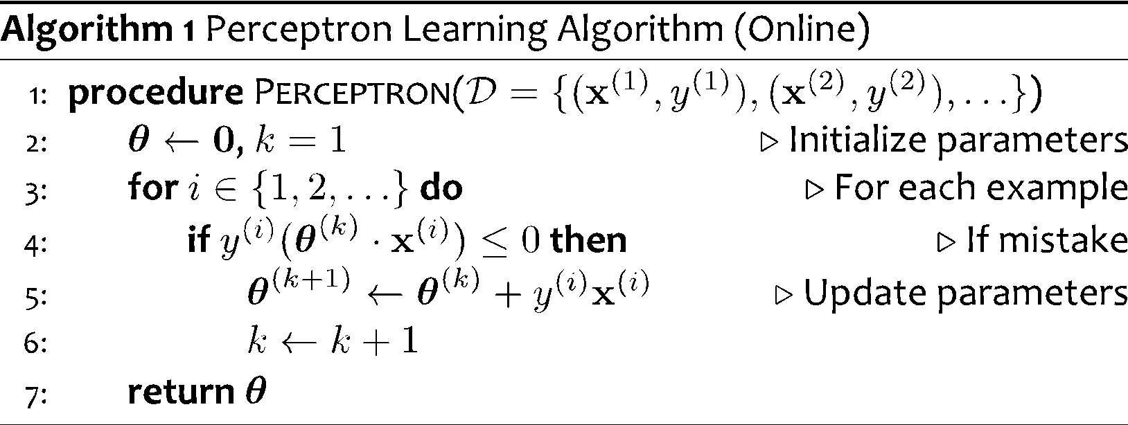
Perceptron for Binary Classification
Note: This is just motivation – we’ll cover the background need to understand these topics later!

Slide 15
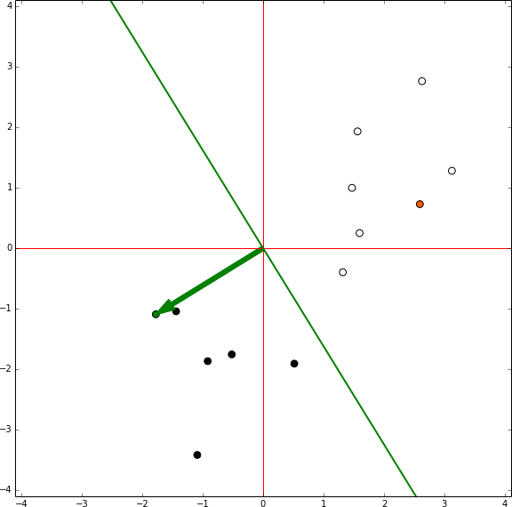
Perceptron for Binary Classification

Slide 16
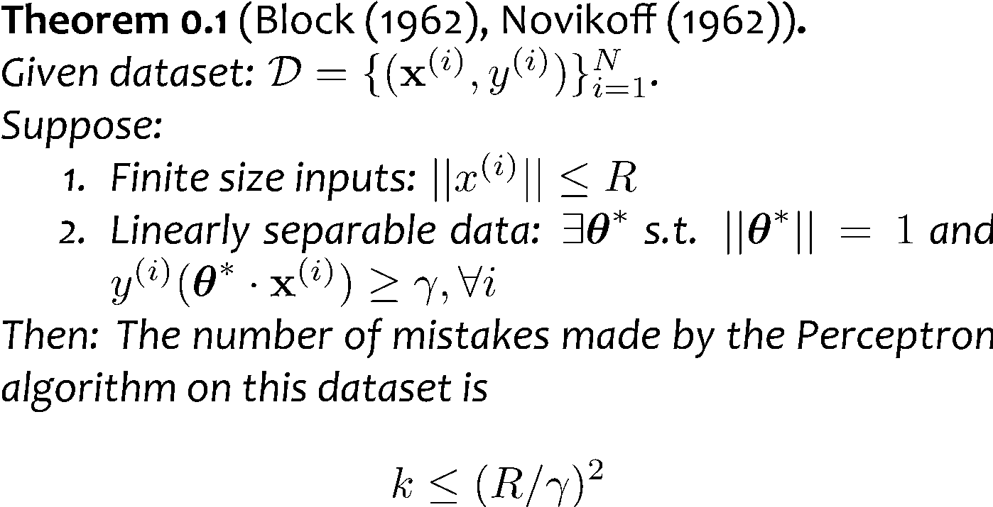

Analysis: Perceptron
Perceptron Mistake Bound
+
+
+
+
γ
+
-
γ
+
+
-
+
-
-
Note: This is just motivation – we’ll cover the background need to understand these topics later!
-
R
-
-
-
-
Figure from Nina Balcan

Slide 17
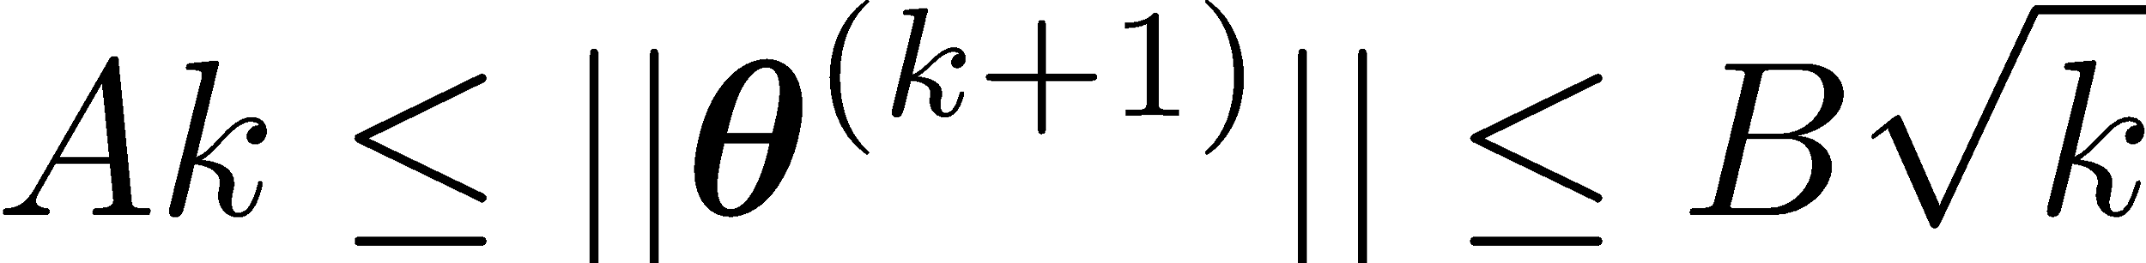
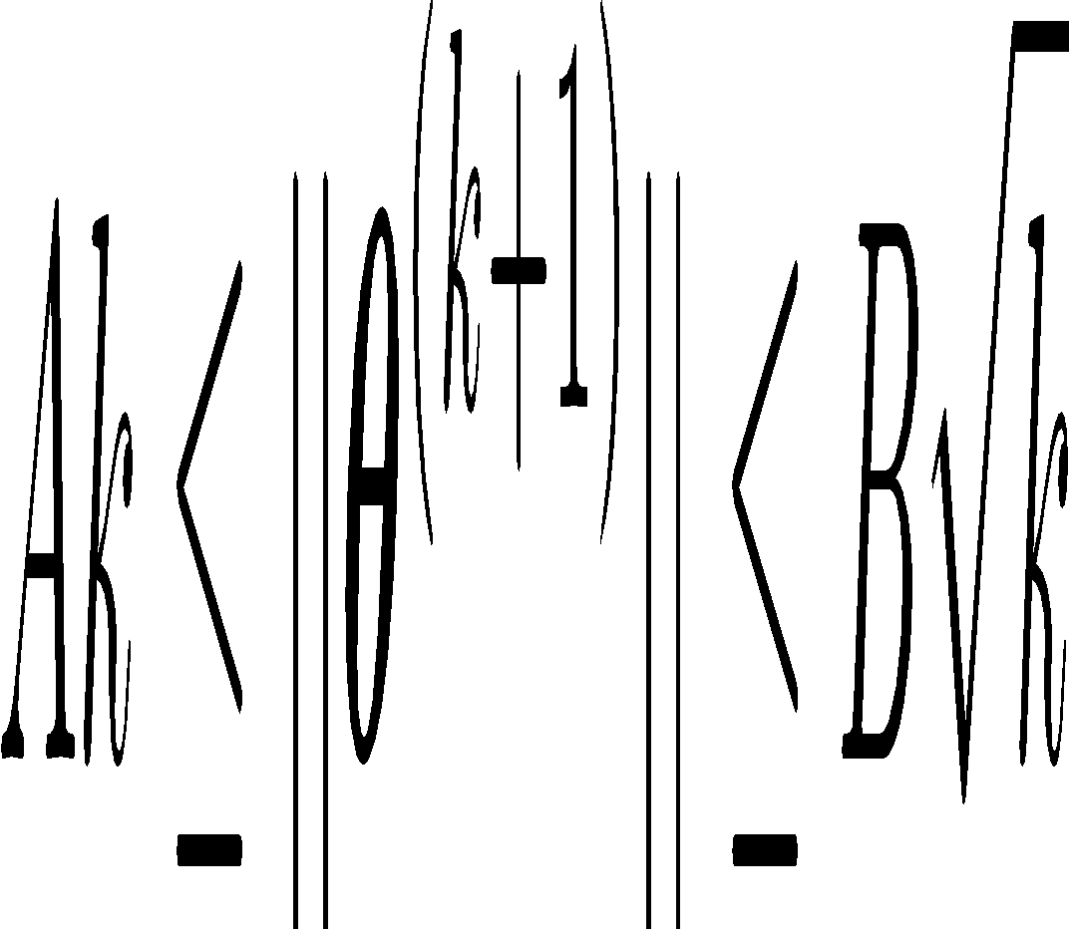
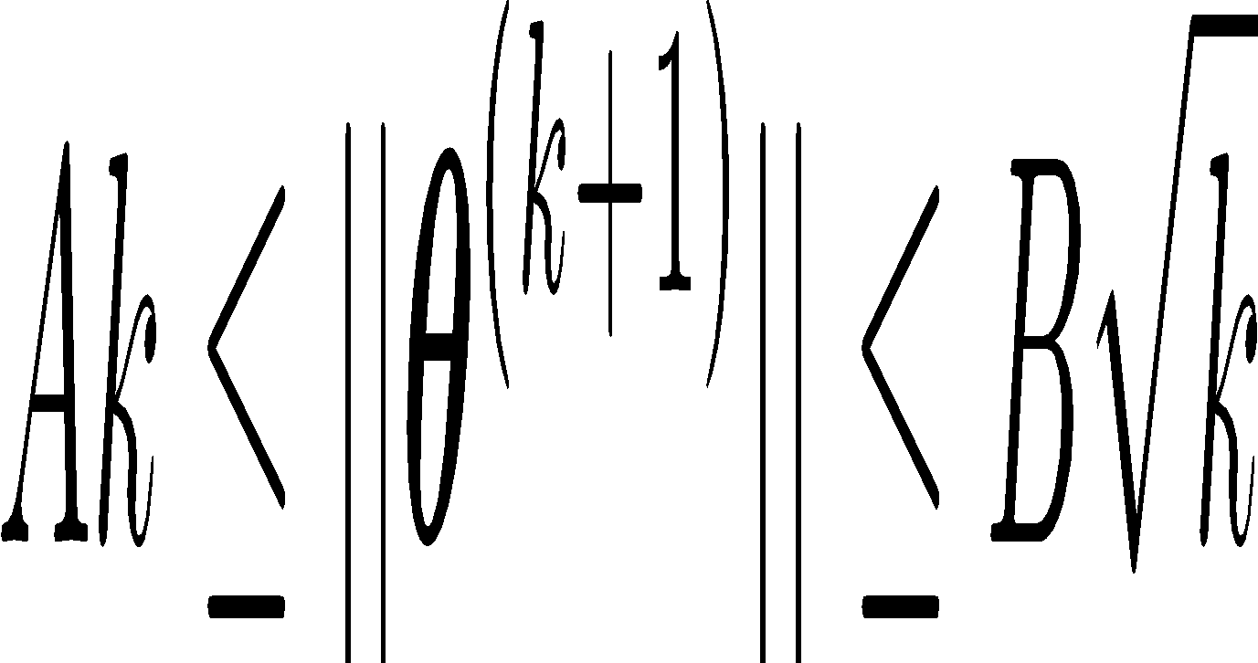
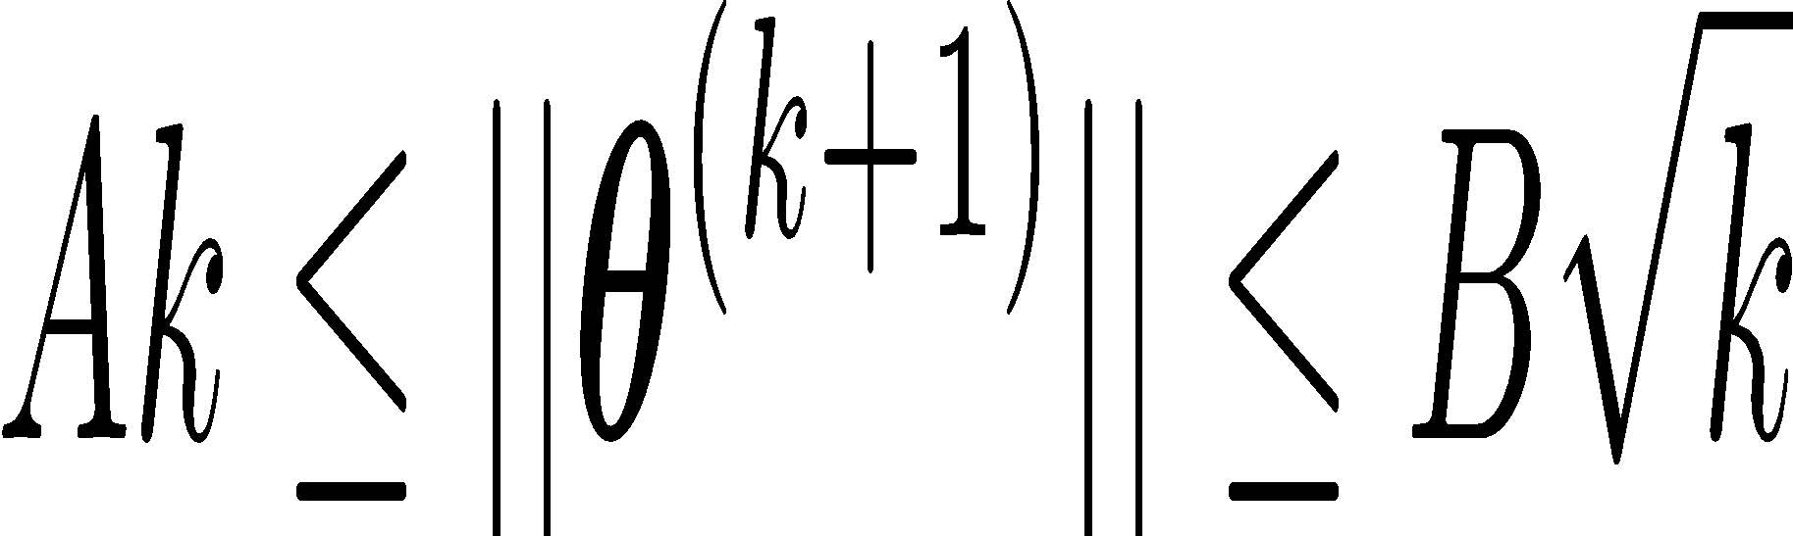
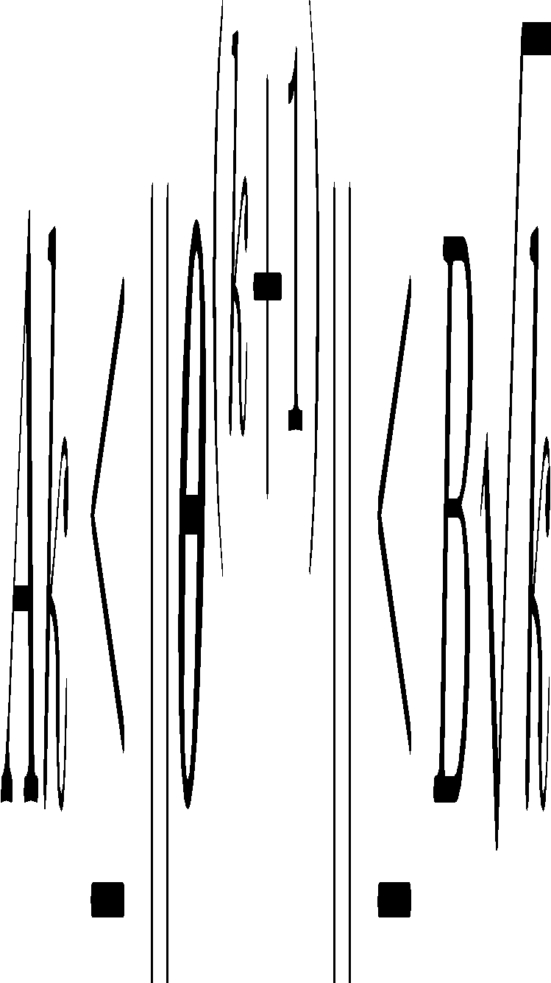
Analysis: Perceptron
Proof of Perceptron Mistake Bound:
We will show that there exist constants A and B s.t.
Note: This is just motivation – we’ll cover the background need to understand these topics later!

Slide 18
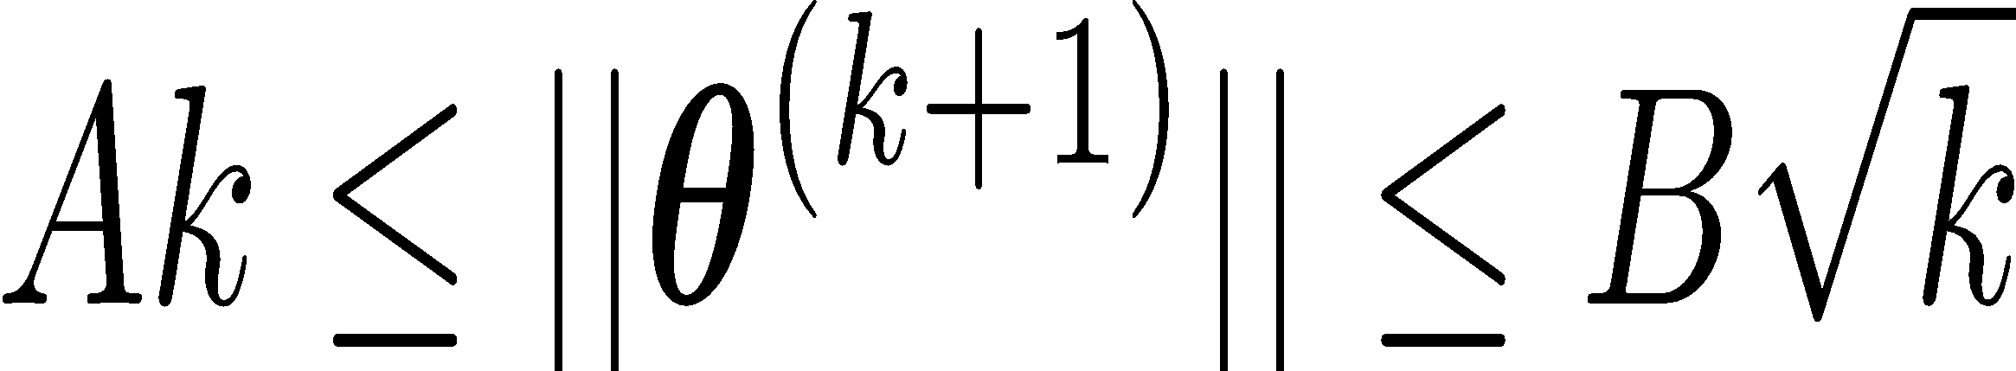
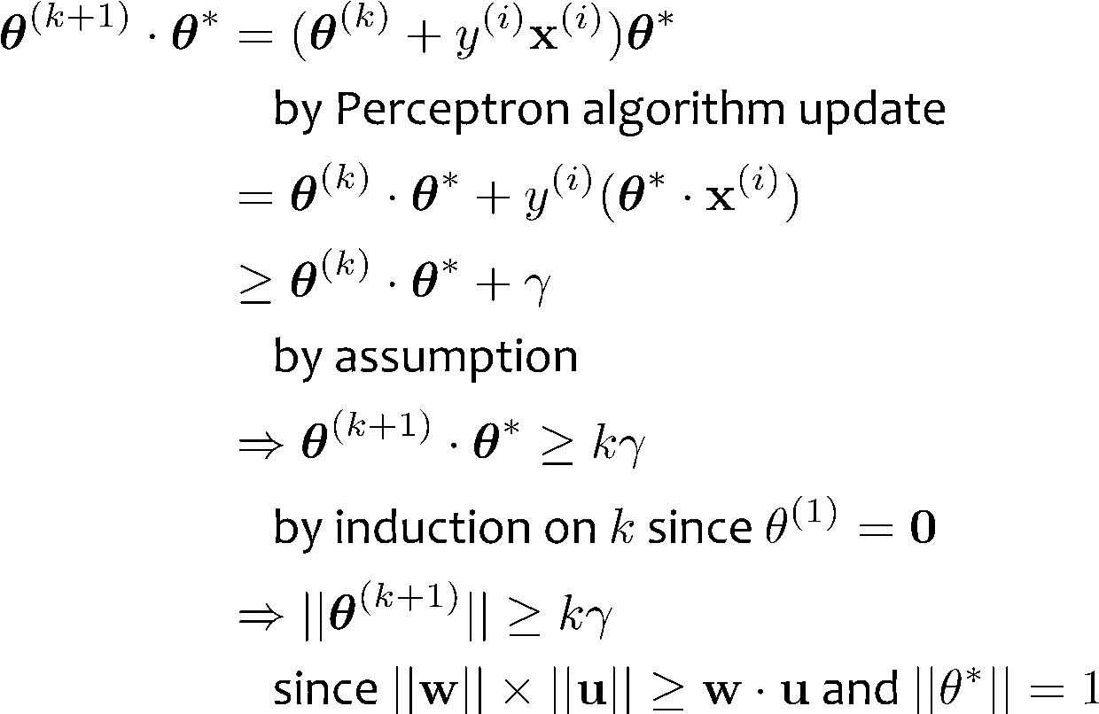
Analysis: Perceptron
Proof of Perceptron Mistake Bound: Part 1: for some A,
Note: This is just motivation – we’ll cover the background need to understand these topics later!
Cauchy-Schwartz inequality
Notes:
Intuition \theta is gradually approaching \theta*
Part 1: The dot product of \theta and \theta* increases rapidly O(k)
Part 2: The norm of \theta increases slowly \Omega(\sqrt(k))

Slide 19
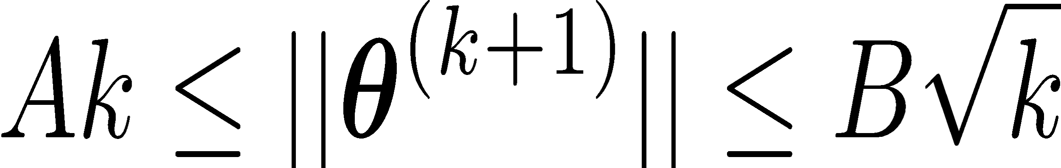
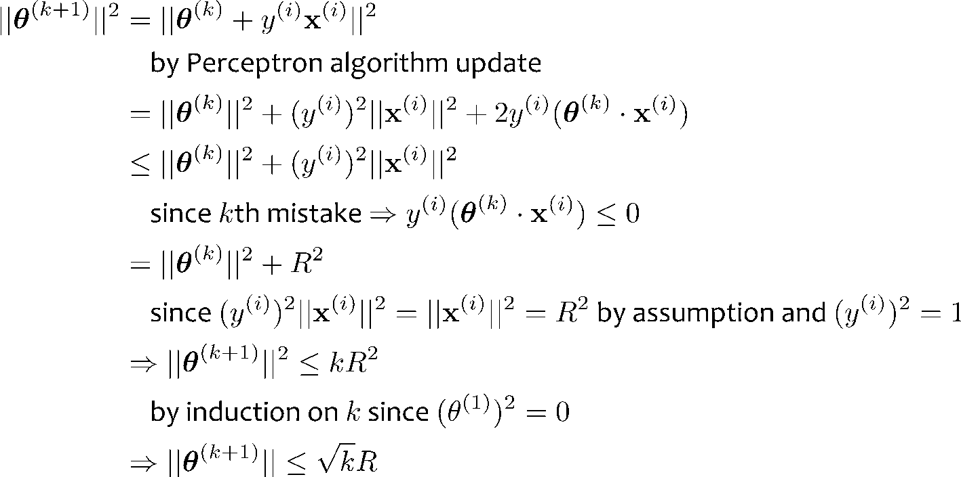
Analysis: Perceptron
Proof of Perceptron Mistake Bound: Part 2: for some B,
Note: This is just motivation – we’ll cover the background need to understand these topics later!
Notes:
Intuition \theta is gradually approaching \theta*
Part 1: The dot product of \theta and \theta* increases rapidly O(k)
Part 2: The norm of \theta increases slowly \Omega(\sqrt(k))

Slide 20
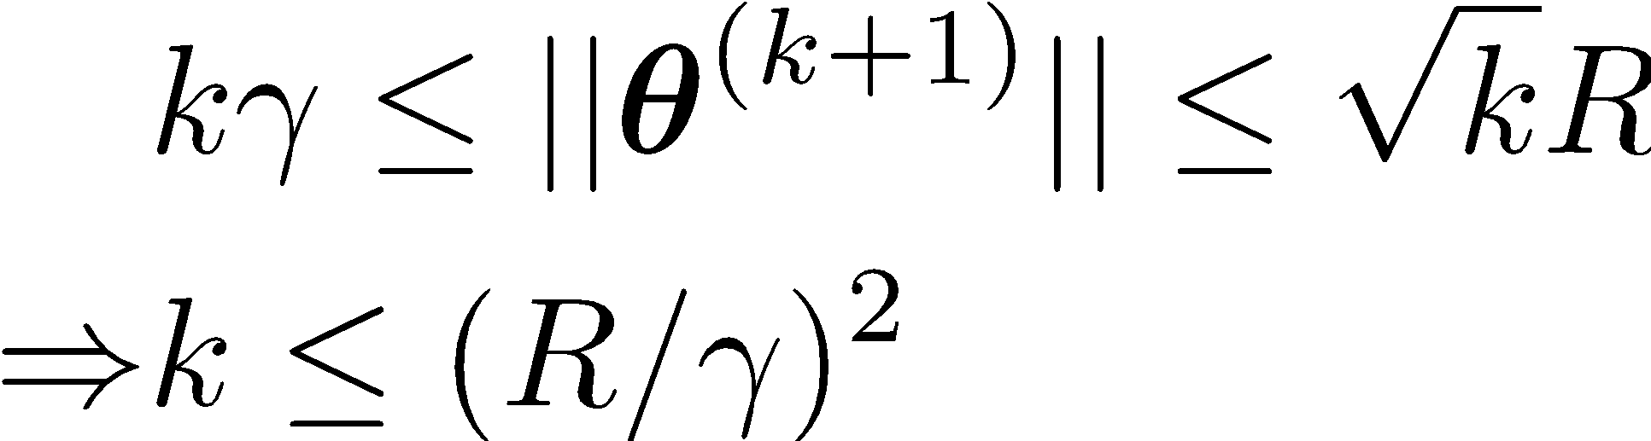
Analysis: Perceptron
Proof of Perceptron Mistake Bound: Part 3: Combining the bounds finishes the proof.
The total number of mistakes must be less than this
Note: This is just motivation – we’ll cover the background need to understand these topics later!

Slide 21
Why Computer Science for ML?
10-607
To best understand A we need B
A | B
Analysis of Exact Inference in Graphical Models | Computation Computational Complexity Recursion; Dynamic Programming Data Structures for ML Algorithms
Implementation Design of a Deep Learning Library | Programming & Efficiency Debugging for Machine Learning Efficient Implementation / Profiling ML Algorithms
Optimization for Support Vector Machines (SVMs) | Optimization Unconstrained Optimization Preconditioning Constrained Optimization
Slide credit: CMU MLD Matt Gormley

Slide 22
Backpropagation
Training
Automatic Differentiation – Reverse Mode (aka. Backpropagation)
Forward Computation
Write an algorithm for evaluating the function y = f(x). The algorithm defines a directed acyclic graph, where each variable is a node (i.e. the “computation graph”)
Visit each node in topological order. For variable u_{i} with inputs v₁,…, v_{N}
Compute u_{i} = g_{i}(v₁,…, v_{N})
Store the result at the node
Backward Computation
Initialize all partial derivatives dy/du_{j} to 0 and dy/dy = 1.
Visit each node in reverse topological order. For variable u_{i} = g_{i}(v₁,…, v_{N})
We already know dy/du_{i}
Increment dy/dv_{j} by (dy/du_{i})(du_{i}/dv_{j}) (Choice of algorithm ensures computing (du_{i}/dv_{j}) is easy)
Slide credit: CMU MLD Matt Gormley
Note: This is just motivation – we’ll cover the math need to understand these topics later!
Return partial derivatives dy/du_{i} for all variables

Slide 23
Propositional Logic and Proofs

Slide 24
Arguments
Assumptions/premises
Steps to make conclusions that follow from premises.
Informal
Formal

Slide 25
Example
Argue that Socrates is mortal!

Slide 26
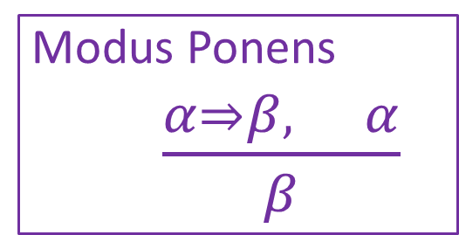
Example
Let’s be more formal:
Give an explicit justification for each statement
based on previous statements.
Prove that Socrates is mortal!
Notation Alert!

Slide 27
Which of the following are valid arguments?
If a meal is a sandwich, it has bread
This meal is a sandwich
Therefore, it has bread
If a bird is a swan, it has white feathers
This bird has white features
Therefore, it is a swan
If the dog is hungry, it will bark
The dog has nor barked
Therefore, it is not hungry

Slide 28
Propositional Logic
Symbol:
Variable that can be true or false
Denoted using letters (a, b, p, q, etc)
Often include True and False (T and F)
Operators/connectives:
¬ A: not A
A ∧ B: A and B (conjunction)
A ∨ B: A or B (disjunction) Note: this is not an “exclusive or”
A ⇒ B: A implies B (implication). If A then B
A ⇔ B: A if and only if B (biconditional)
to construct expressions/sentences

Slide 29
Propositional Logic Semantics
Truth Tables for ∧ and ∨
𝛂 | 𝛃 | 𝛂 ∧ 𝛃
F | F | F
F | T | F
T | F | F
T | T | T
𝛂 | 𝛃 | 𝛂 ∨ 𝛃
F | F | F
F | T | T
T | F | T
T | T | T

Slide 30
Notes on Operators
𝛂 ∨ 𝛃 is inclusive or, not exclusive

Slide 31
Notes on Operators
𝛂 ∨ 𝛃 is inclusive or, not exclusive
𝛂 ⇒ 𝛃 is equivalent to ¬𝛂 ∨ 𝛃
Says who?

Slide 32
Truth Tables
𝛂 ⇒ 𝛃 is equivalent to ¬𝛂 ∨ 𝛃
𝛂 | 𝛃 | 𝛂 ⇒ 𝛃 | ¬𝛂 | ¬𝛂 ∨ 𝛃
F | F | T | T | T
F | T | T | T | T
T | F | F | F | F
T | T | T | F | T

Slide 33
One interesting consequence:
If a is always false, then a ⇒ b is true for any b!
(i.e., ¬a ∨ b is always true)
“If pigs can fly, then 1 + 2 = 5” is true!

Slide 34
Notes on Operators
𝛂 ∨ 𝛃 is inclusive or, not exclusive
𝛂 ⇒ 𝛃 is equivalent to ¬𝛂 ∨ 𝛃
Says who?
𝛂 ⇔ 𝛃 is equivalent to (𝛂 ⇒ 𝛃) ∧ (𝛃 ⇒ 𝛂)
Prove it!

Slide 35
Truth Tables
𝛂 ⇔ 𝛃 is equivalent to (𝛂 ⇒ 𝛃) ∧ (𝛃 ⇒ 𝛂)
𝛂 | 𝛃 | 𝛂 ⇔ 𝛃 | 𝛂 ⇒ 𝛃 | 𝛃 ⇒ 𝛂 | (𝛂⇒𝛃) ∧ (𝛃⇒𝛂)
F | F | T | T | T | T
F | T | F | T | F | F
T | F | F | F | T | F
T | T | T | T | T | T
Equivalence: it’s true in all models. Expressed as a logical sentence:
(𝛂 ⇔ 𝛃) ⇔ [(𝛂 ⇒ 𝛃) ∧ (𝛃 ⇒ 𝛂)]

Slide 36
Truth tables
Exercise: use a truth table to prove that (p ⇔ q) ⇔ (p ∧ q) ∨ (¬p ∧ ¬q)

Slide 37
Exercise 1
If we know that 𝐴 ∨ 𝐵 and ¬𝐵 ∨ 𝐶 are true, what do we know about 𝐴 ∨ 𝐶?
𝐴 ∨ 𝐶 is guaranteed to be true
𝐴 ∨ 𝐶 is guaranteed to be false
We don’t have enough information to say anything definitive about 𝐴 ∨ 𝐶

Slide 38
Exercise 2
If we know that 𝐴 ∨ 𝐵 and ¬𝐵 ∨ 𝐶 are true, what do we know about 𝐴?
𝐴 is guaranteed to be true
𝐴 is guaranteed to be false
We don’t have enough information to say anything definitive about 𝐴

Slide 39
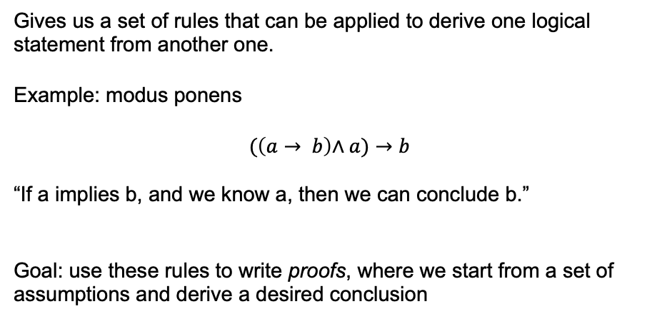
Inference rules
Gives us a set of rules that can be applied to derive one logical statement from another one.
Example: modus ponens
$$(\left(a→ b\right)\text{∧} a)→b$$
“If a implies b, and we know a, then we can conclude b.”
Goal: use these rules to write proofs, where we start from a set of assumptions and derive a desired conclusion

Slide 40
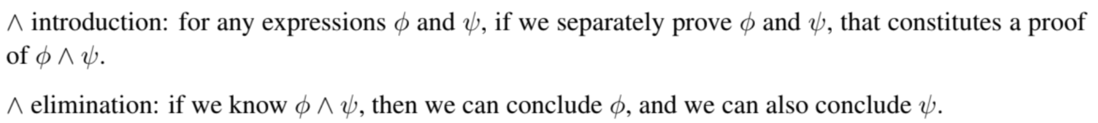
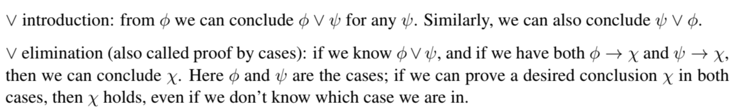
Inference rules

Slide 41
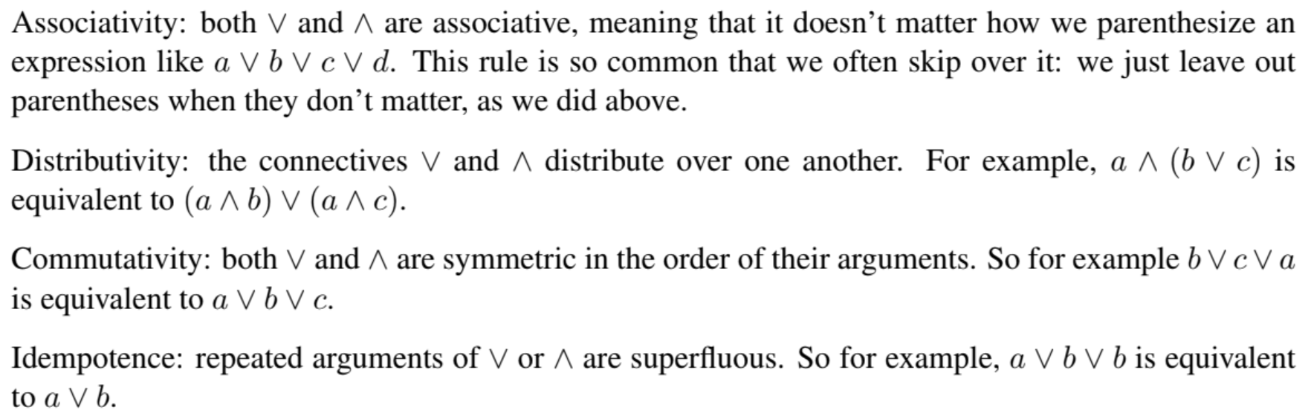
Inference rules

Slide 42
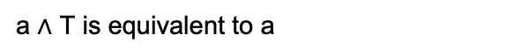
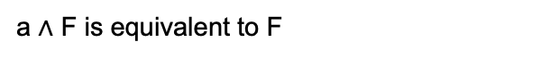
Inference rules
Dominance:
a $\text{∧}$ F is equivalent to F
a $\text{∧}$ T is equivalent to a
a ∨ F is equivalent to a
a ∨ T is equivalent to T

Slide 43
Inference rules
Double negation: ¬¬a is equivalent to a
De Morgan’s laws:
¬(a ∨ b) is equivalent to (¬a ∧ ¬b)
¬(a ∧ b) is equivalent to (¬a ∨ ¬b)
Law of excluded middle: ¬a ∨ a is equivalent to T
Contradiction: ¬a ∧ a is equivalent to F

Slide 44
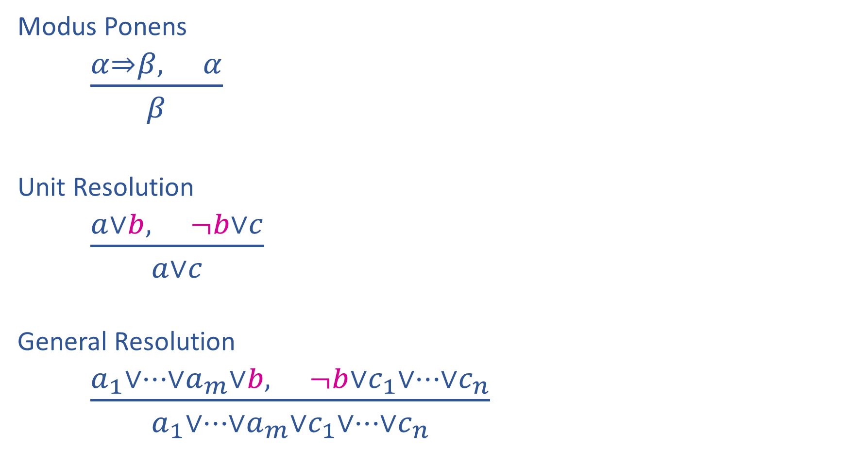
Inference rules

Slide 45
Two-column proofs
To practice being very explicit about reasoning, we will ask you to write proofs in “two-column” format
First column: statement
Second column: reasoning (previous statements + inference rules)

Slide 46
Prove: (p ⇔ q) ⇔ (p ∧ q) ∨ (¬p ∧ ¬q)
Notes:
Rewrite bidirectional as two or statements, then distribute, use contradiction to simplify

Slide 47

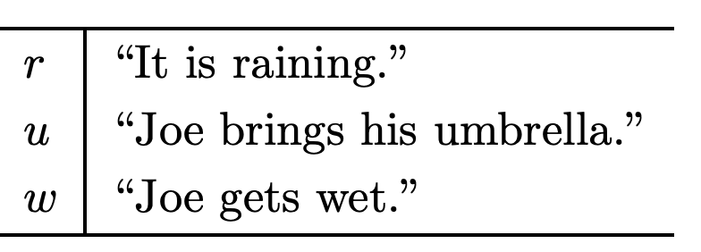
Prove: ¬w
http://infolab.stanford.edu/~ullman/focs/ch12.pdf
Notes:
Introduce r or not r with excluded middle. Then, proof by cases. R: go r -> u, then u to not w. not R: conclude not w. proof by cases: not w

Slide 48
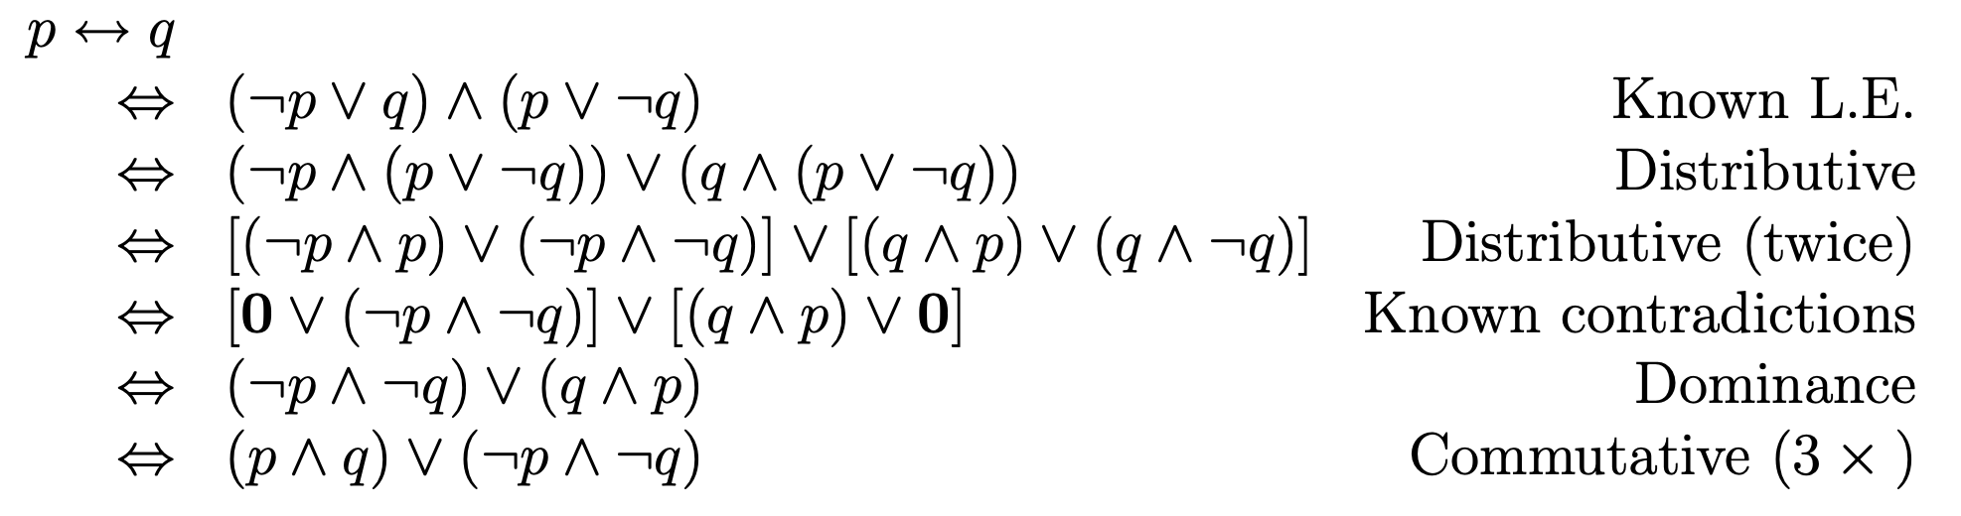

Slide 49
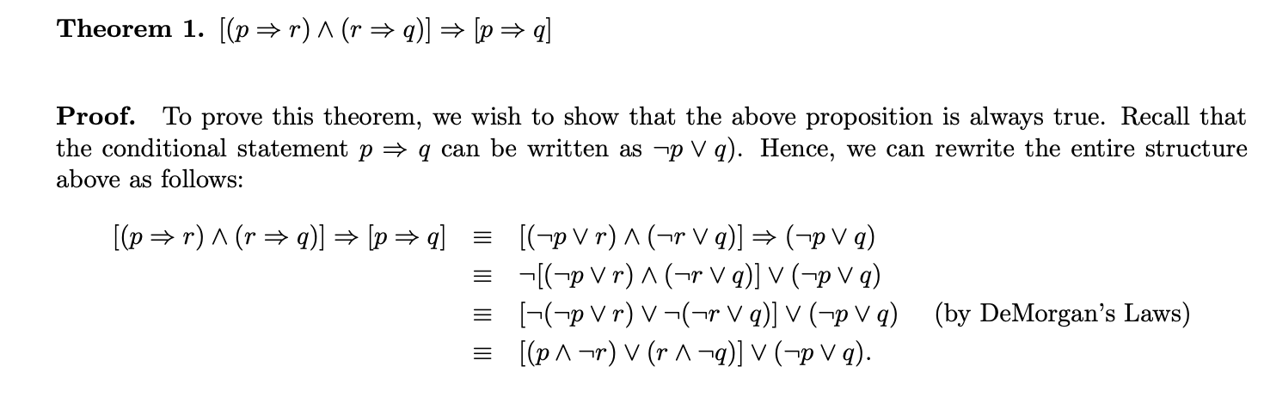
Example 2 column proof

Slide 50
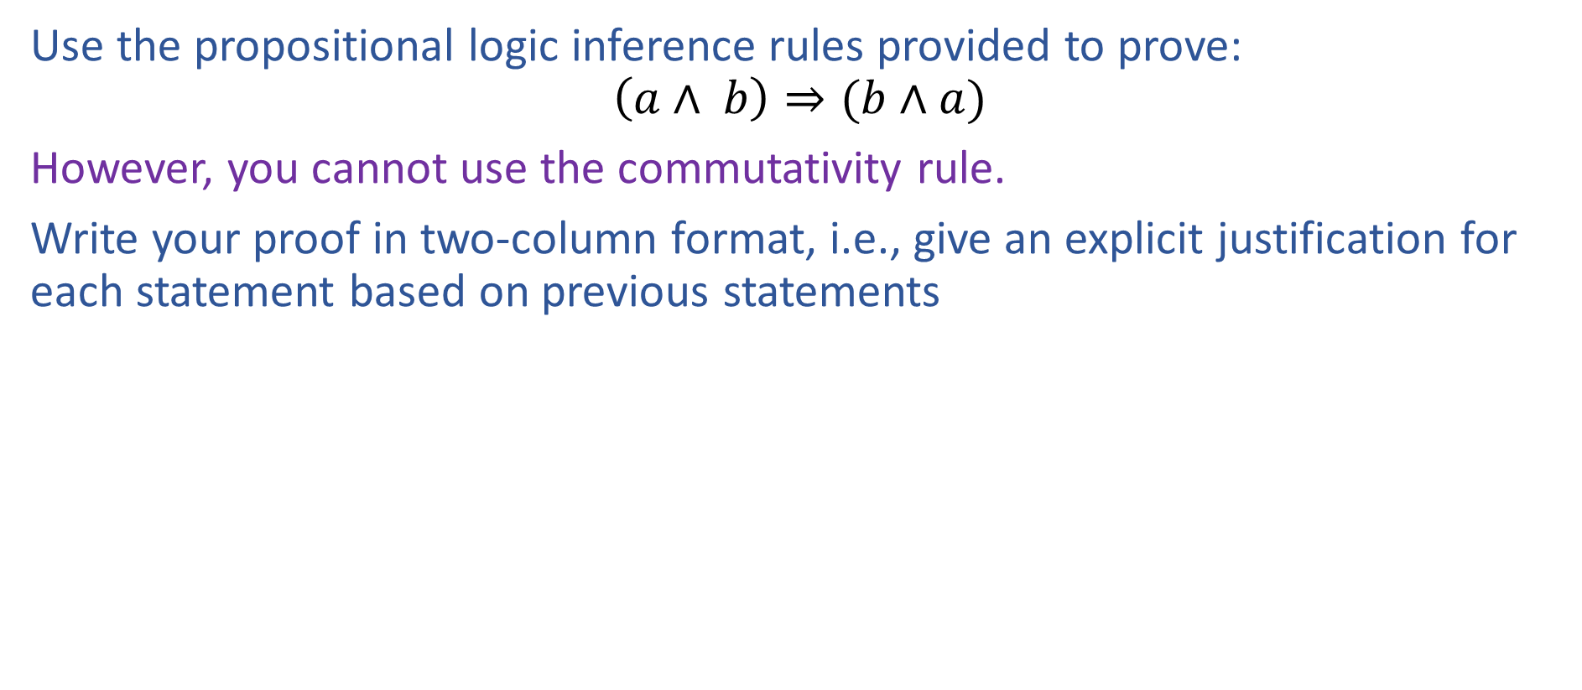
Exercise

Slide 51
(a ^ b) -> (b ^ a)
!(a ^ b) u (b ^ a)
(a! u !b) u (b ^ a)
(a u !a)
(b u !b)
(a u !a) ^ (b u !b)
(a u !a) ^ b u (a u !a) ^ !b
(a^b u !a^ b) u (a^!b u !a ^ !b)

